Slide 1
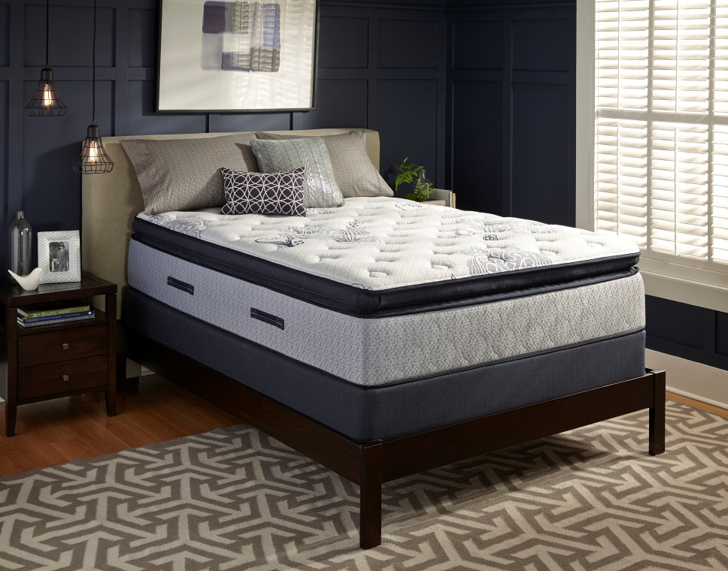
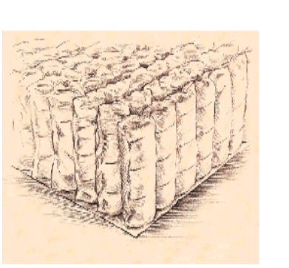
Introducing….
Special Sealy Product Collection
Featuring our Advanced Marshal Coil Innerspring

Slide 2
Special Purchase Assortment
Products with features and specifications normally costing hundreds of dollars more
  Block Foam Encased Innerspring
  Advanced Marshal Coil Innerspring
    8” Heavy Duty 13 ¾ Gauge Coil reinforced with a 9 gauge border rod
    Gel Infused Foam
3 Products hitting key Feels and Constructions
  Plush Tight Top
  Firm Tight Top
  Plush Euro Pillow top

Slide 3
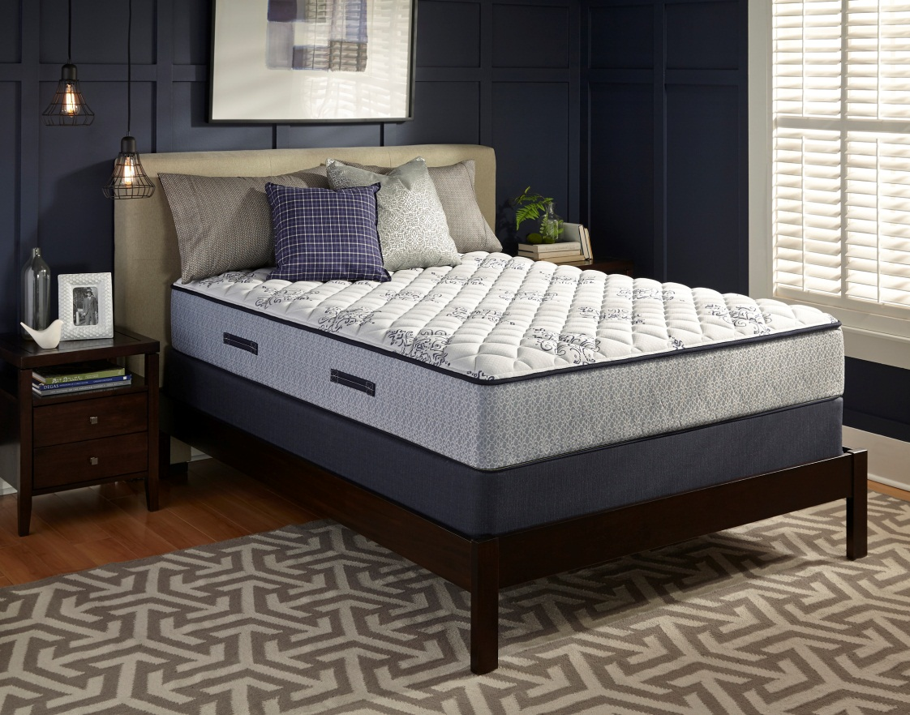
Level 6 Firm Galston Park
Marshal Coil Innerspring
Encased Foam Edge System with a Border Rod
Layers of Sealy Convoluted Foam
Gel Infused Foam
Mattress Height 12.5”

Slide 4
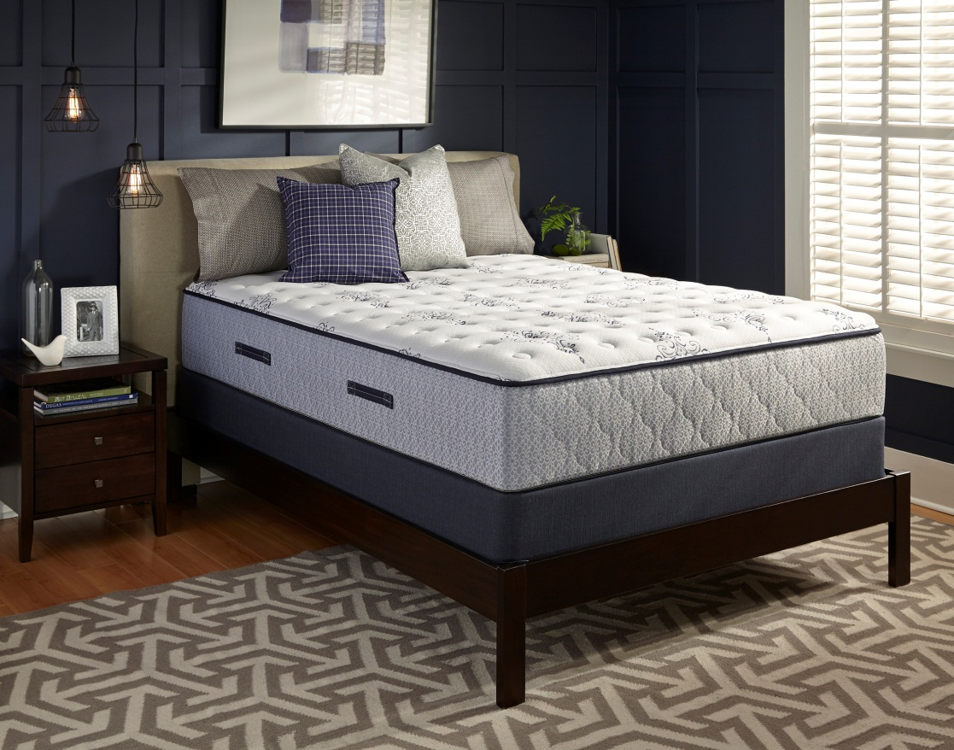
Level 6 Plush Galston Park
Marshal Coil Innerspring
Encased Foam Edge System with a Border Rod
Layers of Sealy Convoluted Foam
Gel Infused Foam
Mattress Height 14.25”

Slide 5
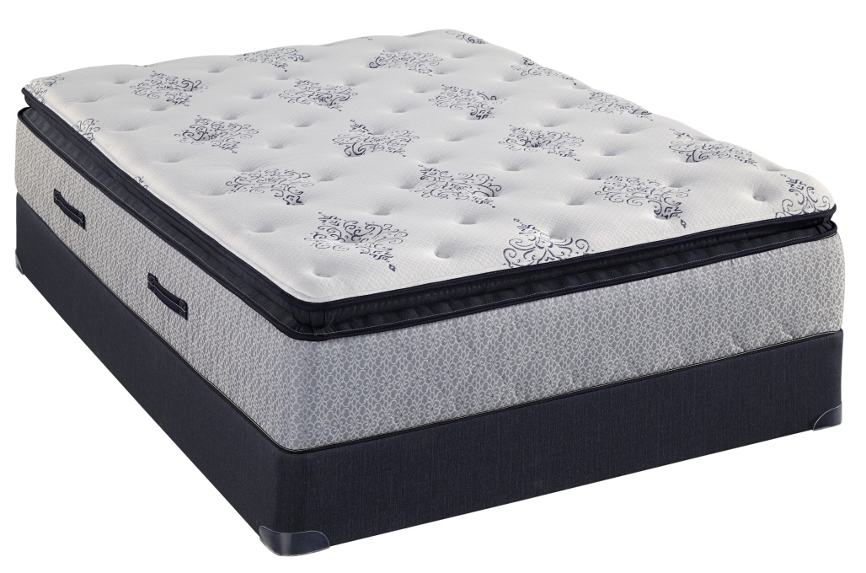
Level 7 Plush Euro Pillow Top Hanging Rock
Euro Pillow Top Construction with an Innerpannel
Marshal Coil Innerspring
Encased Foam Edge System with a Border Rod
Layers of Sealy Convoluted Foam
Gel Infused Foam
Mattress Height 15”

Slide 6

2015 SEALY MT. RUSHMORE COLLECTION
 | Galston Park Firm | Galston Park Plush | Hanging Rock PLEPT
Level | Level 6 | Level 6 | Level 7
Qui l t | FlameGuard Rayon Fiber | FlameGuard Rayon Fiber | FlameGuard Rayon Fiber
 | 3/4" Firm Foam | 2" x 1/2" Convoluted Foam | 1/2" Super Soft Foam
 | 3/4" Firm Foam |  | 2" x 1/2" Convoluted Foam
Comfort Layers | 1” Gel OrthoZone II Foam | Gel OrthoZone II Foam | 2" Super Soft Foam
 | Resilium |  | Versare Inner Panel
 |  | Resilium | Gel OrthoZone II Foam
 |  | 1 ½” SuperSoft Sealy Foam | Resilium
 |  | Versare Insulator | Versare Insulator
Innerspring Edge Support | 825 Coil Density Double Tempered Pocketed Coil Innerspring | 825 Coil Density Double Tempered Pocketed Coil Innerspring | 825 Coil Density Double Tempered Pocketed Coil Innerspring
 | Foam Encased Perimeter | Foam Encased Perimeter | Foam Encased Perimeter
Handles | 1.5" Warranted Cloth Handles | 1.5" Warranted Cloth Handles | 1.5" Warranted Cloth Handles
Foundation | SemiFlex Foundation | SemiFlex Foundation | SemiFlex Foundation
Warrantyy | 10 yrs Non Prorated | 10 yrs Non Prorated | 10 yrs Non Prorated

Slide 7
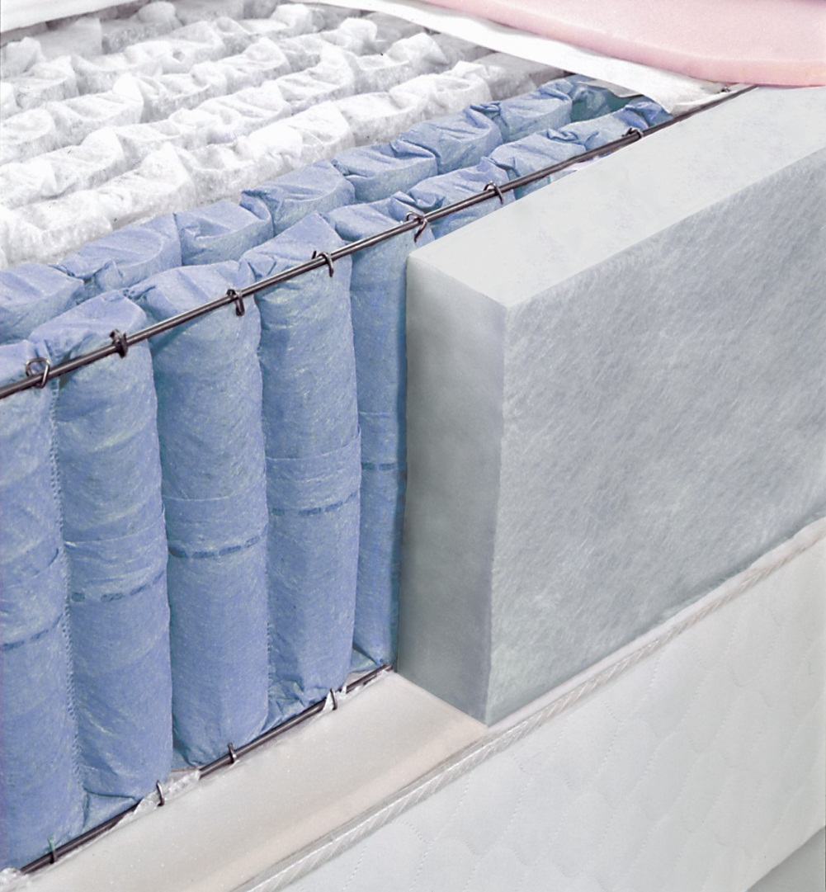
Key Product Features
Marshal Coil Innerspring
Pocketed Coil, 13 ¾” gauge, 8” tall
Features tempered steel which locks in the memory of the coil so it retains its shape and reduces Motion
Encased Edge System
2 1/2 “ thick perimeter foam surrounds the Innerspring.
9 gauge border rod adds additional support and stability

